Slide 1
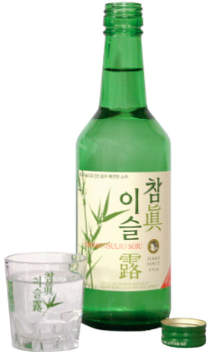


High School Alcoholism and Academic Performance
BDA 2025 GrosseDaten

Slide 2
Google Colab notebook
Dataset in use
https://colab.research.google.com/drive/1pclpyWptryqBZfFNfx2YKgYegZJ2JiA9
https://www.kaggle.com/datasets/gabrielluizone/high-school-alcoholism-and-academic-performance

Slide 3
31 x 649
features
rows

Slide 4
Features
school
sex
age
address
famsize
Pstatus
Medu
Fedu
Mjob
Fjob
reason
guardian
traveltime
studytime
schoolsup
famsup
paid
activities
nursery
higher
internet
romantic
famrel
freetime
goout
Dalc
Walc
health
absences
G1
G2

Slide 5
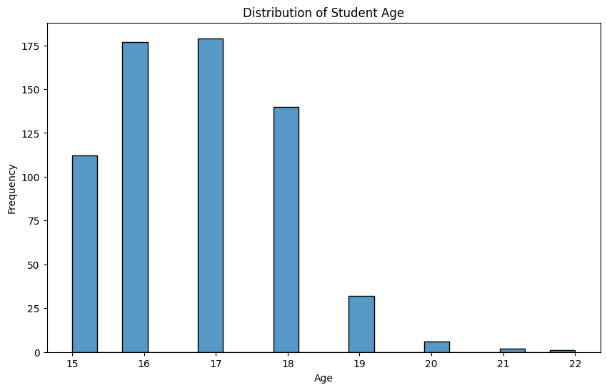
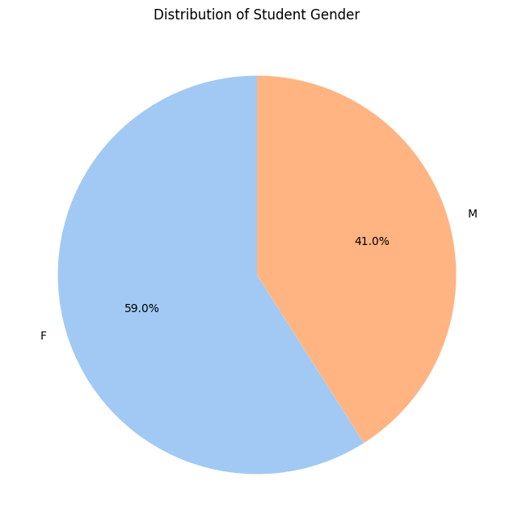

Slide 6
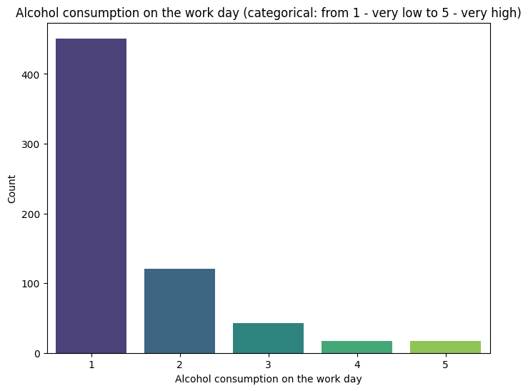

Slide 7
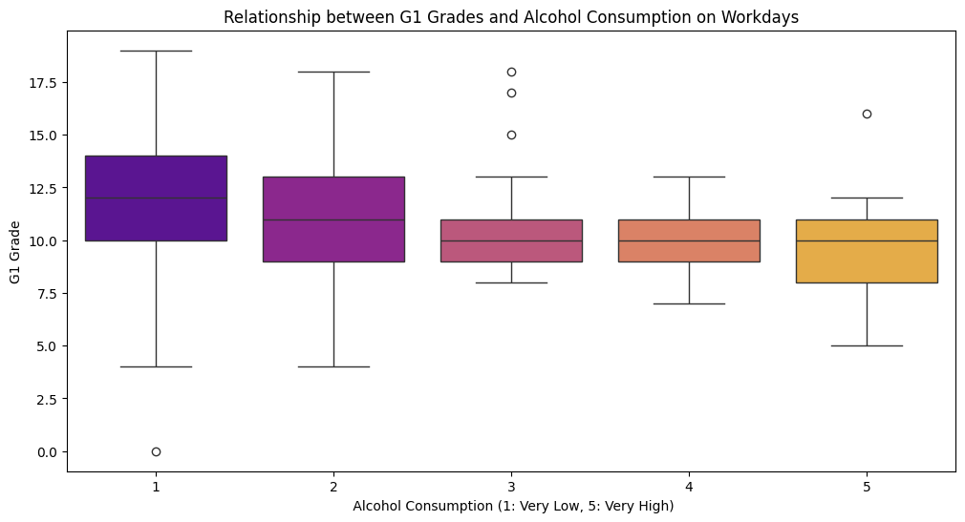
Notes:
“Let’s now take a closer look at alcohol consumption patterns between weekdays and weekends. Unsurprisingly, weekend drinking — labeled here as 'Walc' — tends to be higher than weekday drinking, or 'Dalc'.
What’s interesting is how this behavior potentially shifts academic performance. Students might manage occasional weekday drinking, but consistent weekend partying can snowball into late nights, poor study habits, and of course, hangovers that bleed into the school week.
The data suggests that students who drink heavily on weekends often experience dips in their academic consistency.”

Slide 8
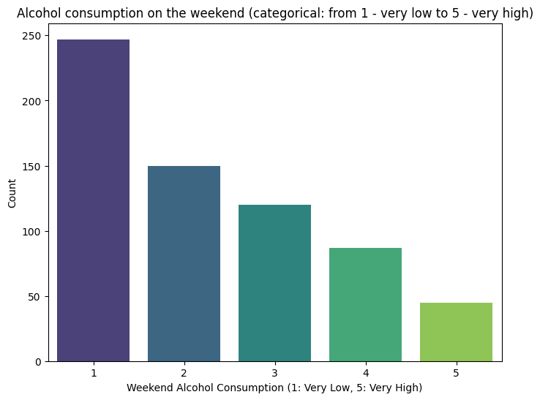

Slide 9
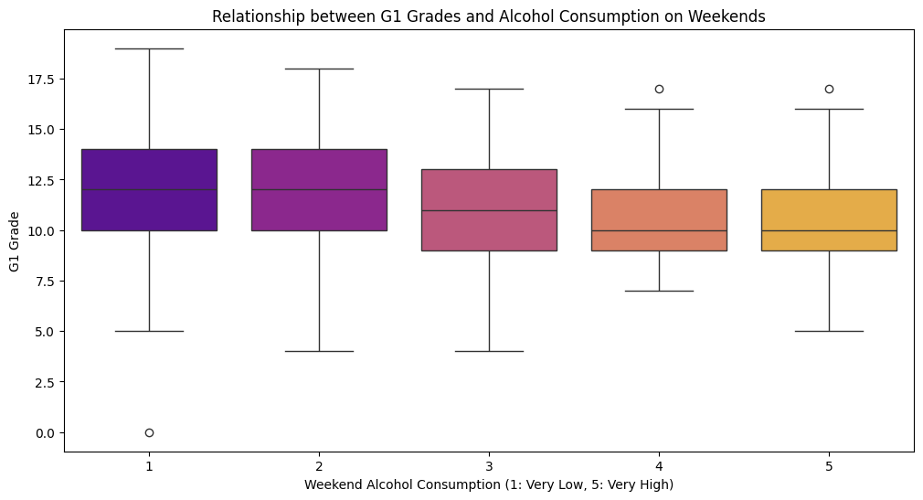

Slide 10
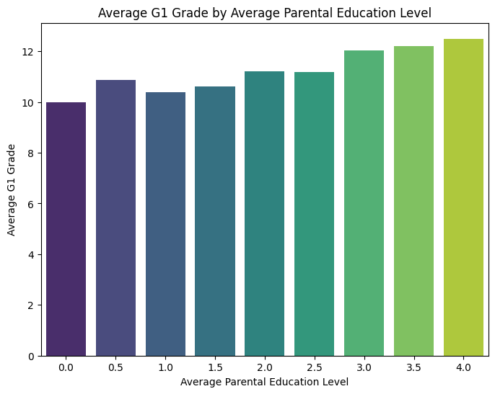

Slide 11
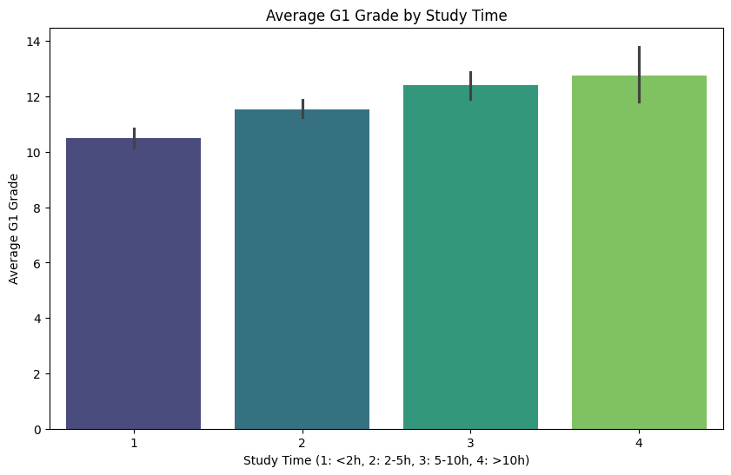

Slide 12
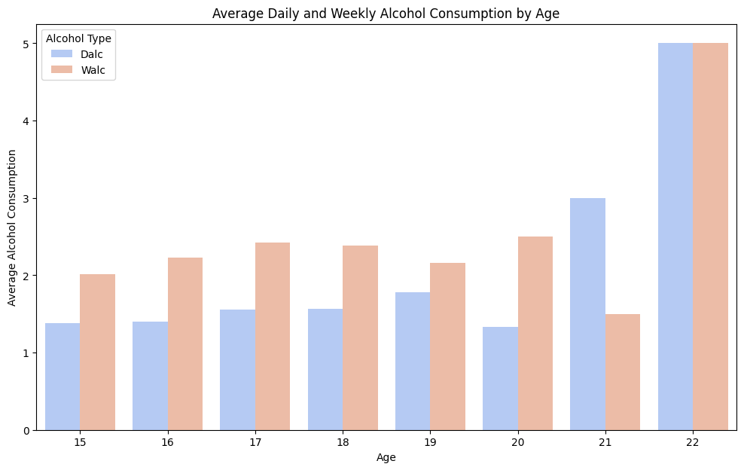
Weekday and Weekend Comparison

Slide 13
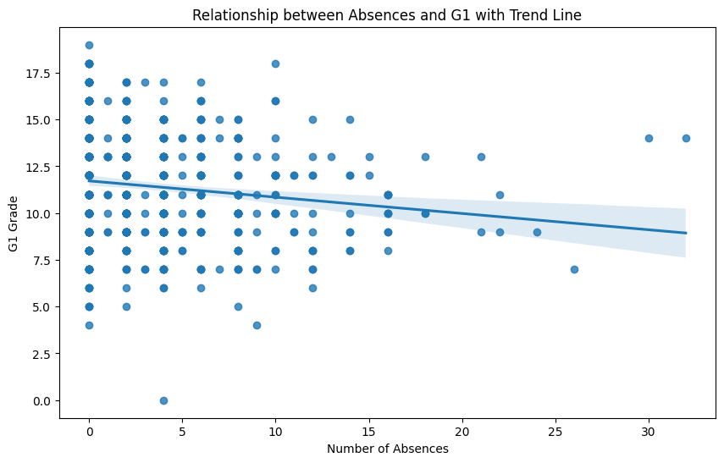

Slide 14
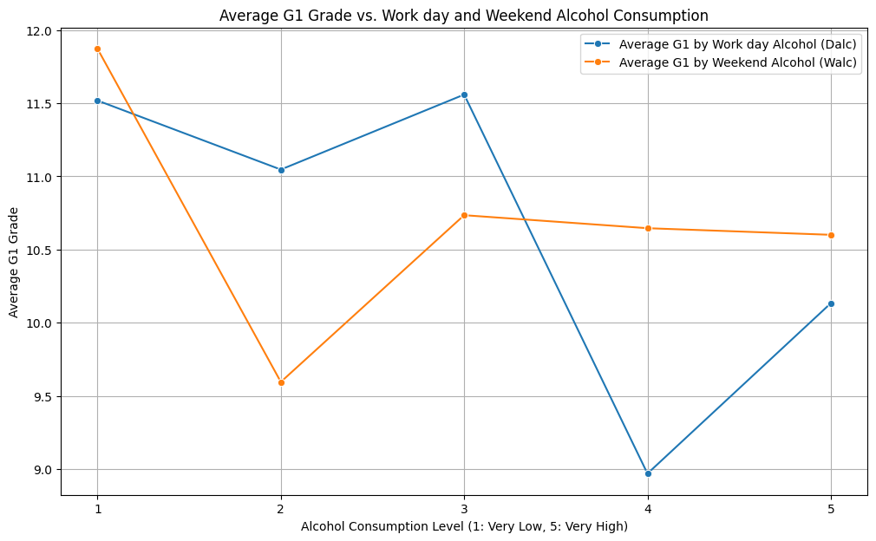
Comparison of the influence of Work day Alcohol consumption and Weekend alcohol consumption

Slide 15
Insights recap
Alcohol Consumption and Grades: Both daily (Dalc) and weekend (Walc) alcohol consumption appear to have some relationship with G1 grades. The box plots suggest that as alcohol consumption levels increase, the median G1 grade might tend to decrease, although this trend might not be strictly linear or strong.
Parental Education and Grades: There appears to be a positive correlation between the average parental education level and the G1 grade. The bar chart suggests that students with higher average parental education levels tend to have higher average G1 grades.
Study Time and Grades: The bar chart indicates a positive trend between study time and G1 grades. Students who report spending more time studying generally have higher average G1 grades.
Absences and Grades: The scatter plot with the trend line suggests a potential negative relationship between the number of absences and G1 grades. As the number of absences increases, the G1 grade might tend to decrease, although the trend line shows the general tendency and individual data points may vary.
Age and Alcohol Consumption: The bar chart showing average daily and weekly alcohol consumption by age provides insights into how alcohol consumption patterns might differ across age groups in this dataset.

Slide 16
Thank you for your attention!

